Slide 1

OS Lab 3- Shell Scripting
Instructor
Aliza Saeed
aliza.saeed@nu.edu.pk

Slide 2
What is “Shell”?
The “Shell” is simply another program which provides a basic human-OS interface.
It is a command interpreter
Built on top of the kernel
Enables users to run services provided by the UNIX/Linux OS
In its simplest form, a series of commands in a file is a shell program that saves having to retype commands to perform common tasks.
How to know what shell you use
echo $SHELL

Slide 3
What is “Shell”?
Shell is an environment in which we can run our commands, programs, and shell scripts
There are different flavors of a shell, just as there are different flavors of operating systems
Each flavor of shell has its own set of recognized commands and functions
Current location of the running shell/bash? Type:
Which bash -> e.g, /bin/bash

Slide 4
Linux Shells
sh Bourne Shell (Original Shell)
bash Bourne Again Shell (GNU Improved Bourne Shell)
csh C-Shell (C-like Syntax)(Bill Joy of Univ. of California)
ksh Korn-Shell (Bourne+some C-shell)(David Korn of AT&T)
tcsh Turbo C-Shell (More User Friendly C-Shell).
To check shell:
$ echo $SHELL (shell is a pre-defined variable)

Slide 5
Pipes
Connect processes using pipe „|‟ operator
Processes connected by pipes can run simultaneously and are automatically scheduled as data flows between them
Using „sort‟ command to sort output from “ls‟ command
# ls | sort

Slide 6
What is shell script?
A shell script is a script written for the shell
The basic concept of a shell script is a list of commands, which are listed in the order of execution
A good shell script will have comments, preceded by # sign, describing the steps.
All the scripts would have the .sh extension

Slide 7
What is shell script?
Before you add anything else to your script, you need to alert the system that a shell script is being started
This is done using the shebang construct.
For example −
#!/bin/bash
This tells the system that the commands that follow are to be executed by the Bourne shell
It's called a shebang because the # symbol is called a hash, and the ! symbol is called a bang
This is the first line of the script above. The hash exclamation mark ( #! ) character sequence is referred to as the Shebang. Following it is the path to the interpreter (or program) that should be used to run (or interpret) the rest of the lines in the text file. (For Bash scripts it will be the path to Bash, but there are many other types of scripts and they each have their own interpreter.)

Slide 8
How to write shell scripts?
Use any editor (kwrite, kate etc) to write shell script
Set the execute permission for your script
through graphical interface
chmod +x script-name
chmod 755 script-name
Execute your script as:
./script-name

Slide 9
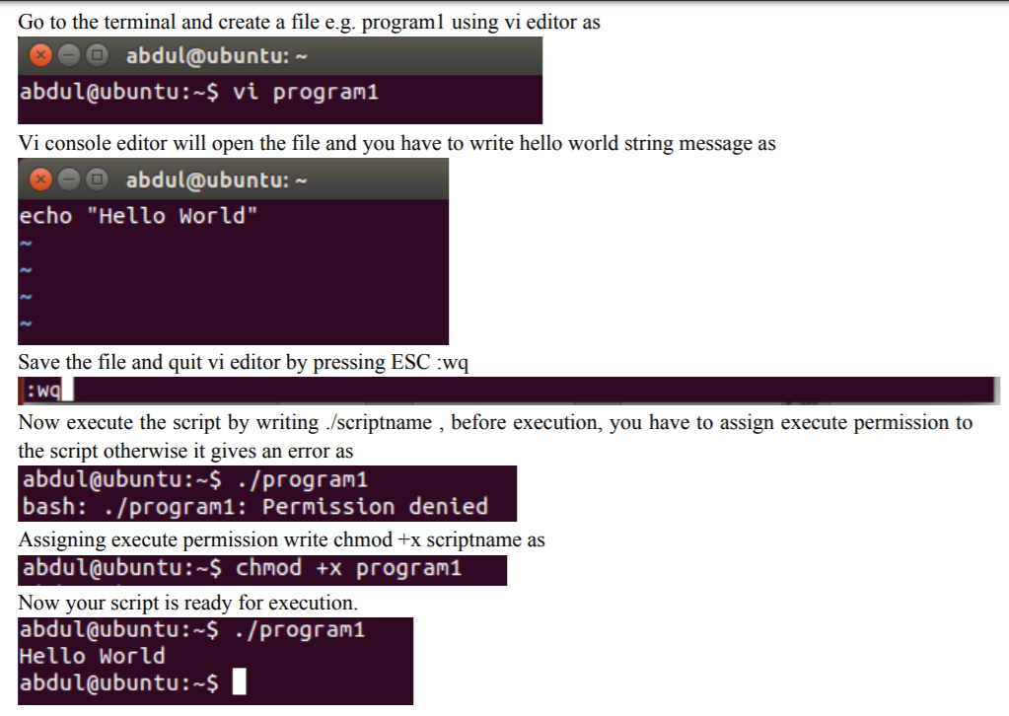

Slide 10
Commenting
Lines starting with # are comments except the very first line where #! indicates the location of the shell that will be run to execute the script.
On any line characters following an unquoted # are considered to be comments and ignored.
Comments are used to;
Identify who wrote it and when
Identify input variables
Make code easy to read
Explain complex code sections
Version control tracking
Record modifications

Slide 11
Variables in Shell
In Linux shell there are three types of variables
System or Environment variables
User defined variables
Parametric variables

Slide 12
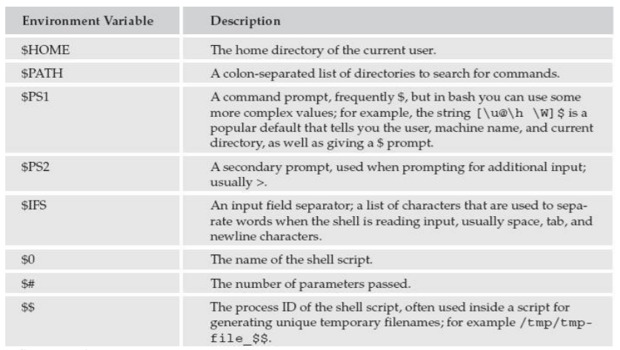

Slide 13
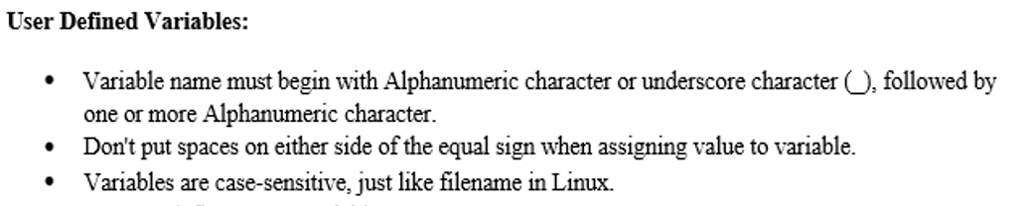
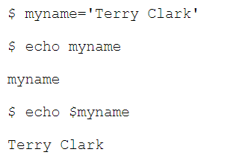

Slide 14
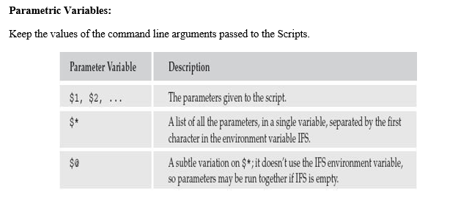
Notes:
Subtle : making use of clever and indirect methods to achieve something.

Slide 15
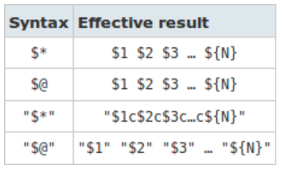

Slide 16

IFS Environment
For many command line interpreters (“shell”) of Unix/Linux operating systems, the internal field separator (abbreviated IFS) refers to a variable which defines the character or characters used to separate a pattern into tokens for some operations.
IFS typically includes
Space
Tab
newline

Slide 17
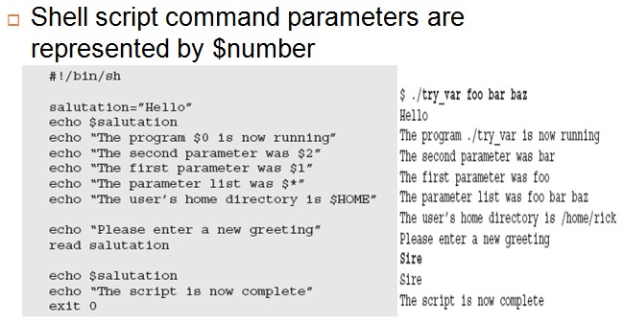
Notes:
The Internal Field Separator (IFS) that is used for word splitting after expansion and to split lines into words with the read builtin command.

Slide 18
A Shell Script Example
#!/bin/bash
# use ‘#” to add comments in shell script
#Author: Aliza Saeed
#shell scripting practice problem
#script follows here:
pwd
Ls

Slide 19
Shell Scripting
Tell Linux that the script file is executable
$ chmod u+x test.sh
$ chmod +x test.sh
Execute the shell-script
$ ./test.sh

Slide 20
My First Shell Script
#! /bin/bash
# The first example of a shell script
directory=`pwd`
echo Hello World!
echo The date today is `date`
echo The current directory is $directory
$ chmod +x myfirstscript.sh
$ ./myfirstscript.sh
Hello World!
The date today is Mon Mar 8 15:20:09 EST 2010
The current directory is /netscr/shubin/test

Slide 21
User Input
As shown on the hello script input from the standard input location is done via the read command.
Example
echo "Please enter three filenames:”
read filea fileb filec
echo “These files are used:$filea $fileb $filec”
Each read statement reads an entire line. In the above example if there are less than 3 items in the response the trailing(losing) variables will be set to blank ‘ ‘.
Three items are separated by one space.

Slide 22
Hello script
The following script asks the user to enter his name and displays a personalised hello.
#!/bin/sh
echo “Who am I talking to?”
read user_name
echo “Hello $user_name”

Slide 23
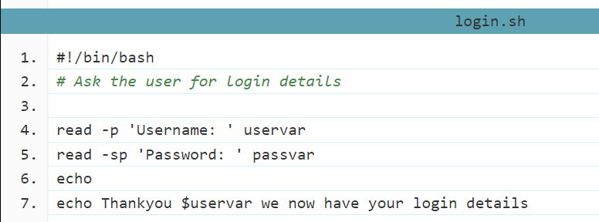
More with Inputs
You are able to alter the behavior of read with a variety of command line options.
Two commonly used options however are -p which allows you to specify a prompt and -s which makes the input silent.
This can make it easy to ask for a username and password combination like the example below:

Slide 24
Arithmetic operations
let expression
Make a variable equal to an expression.
expr expression
print out the result of the expression.
$(( expression ))
Return the result of the expression.
${#var}
Return the length of the variable var.

Slide 25
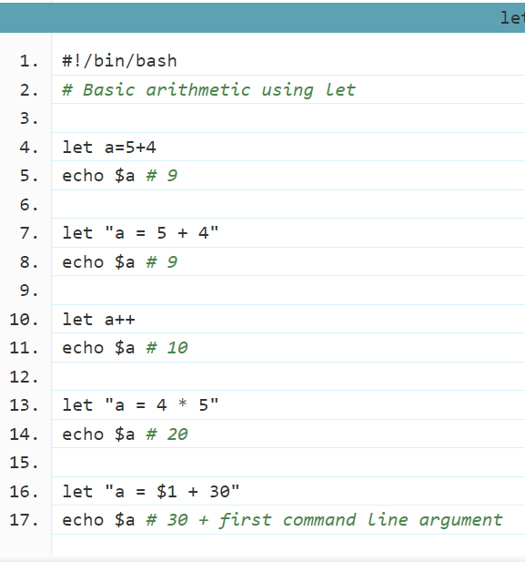
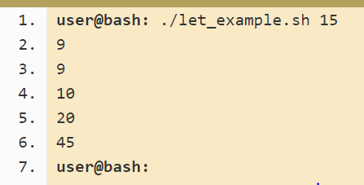

Slide 26
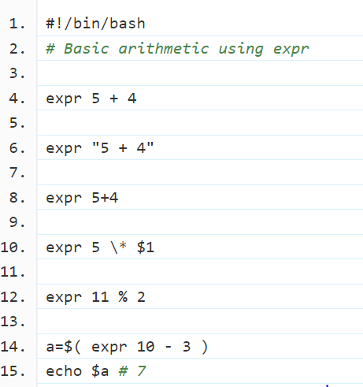
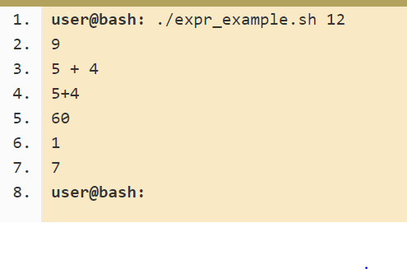

Slide 27
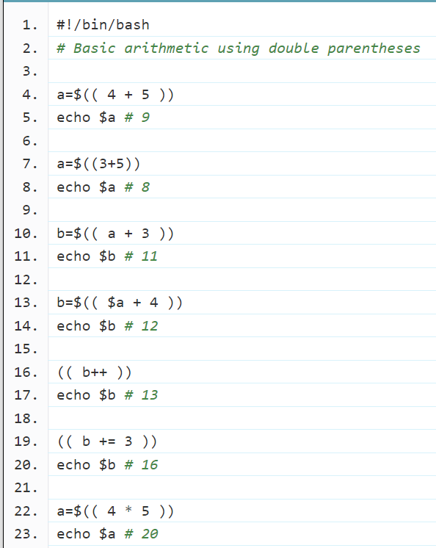
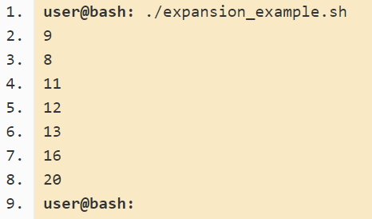

Slide 28
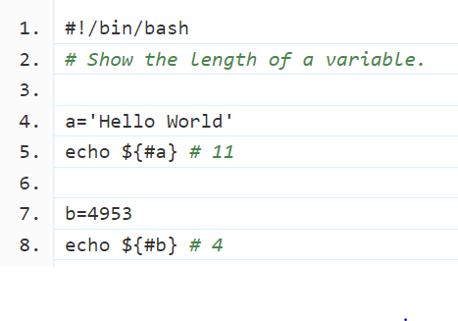
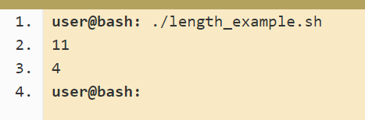

Slide 29
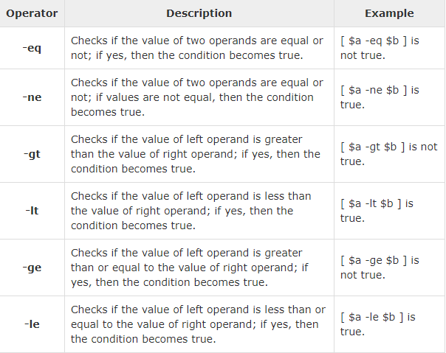
Relational operators

Slide 30
#!/bin/sh
a=10
b=20
if (( $a == $b ))
then
echo "$a -eq $b : a is equal to b"
else
echo "$a -eq $b: a is not equal to b"
fi
if [ $a -ne $b ]
then
echo "$a -ne $b: a is not equal to b"
else
echo "$a -ne $b : a is equal to b"
fi

Slide 31

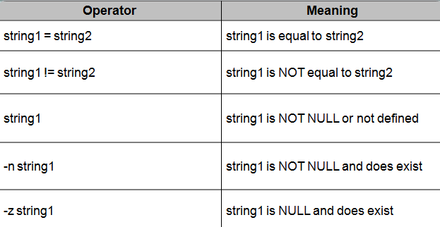
String Comparison

Slide 32
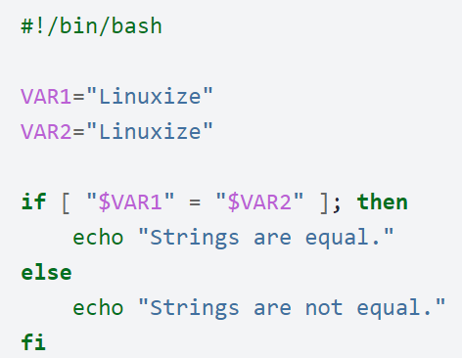
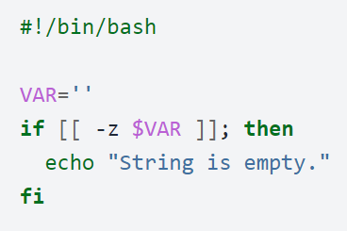

Slide 33

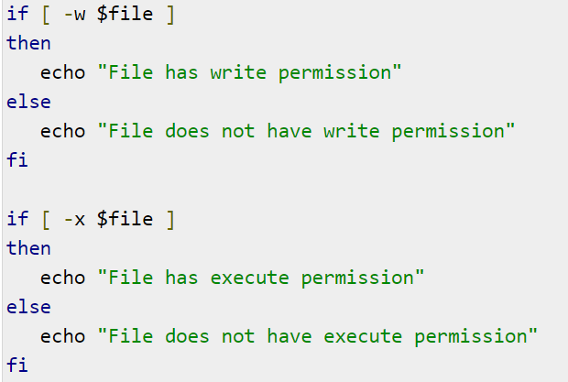
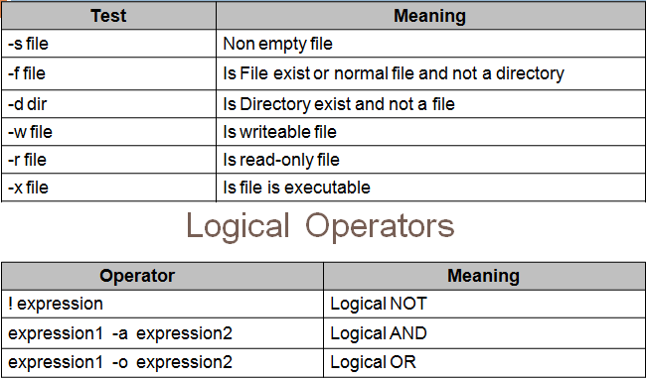
Other operators

